Slide 1


ABOUT SPARKT
Where brand thinking
meets the craft of making.
CONSULTING · COMMUNICATION · CONTENT · INFLUENCE · TECHNOLOGY

Slide 2
HOW WE PARTNER
Built around your business.
We don’t bring a fixed playbook. We build around the category, the consumer, the culture and the business reality.
01
Tailored thinking, not one-size-fits-all
02
You know the category. We know how to unlock it.
Every challenge deserves its own approach.
Partnership starts with respect for your expertise.
03
Culture before communication
04
Ideas before channels
Behaviour and context before the message.
The strategy & idea leads. The channel follows.
05
Business outcomes before outputs
06
Trust makes brave work possible
We solve for growth, trust, clarity and demand.
Clear, honest partnership makes the work better.

Slide 3
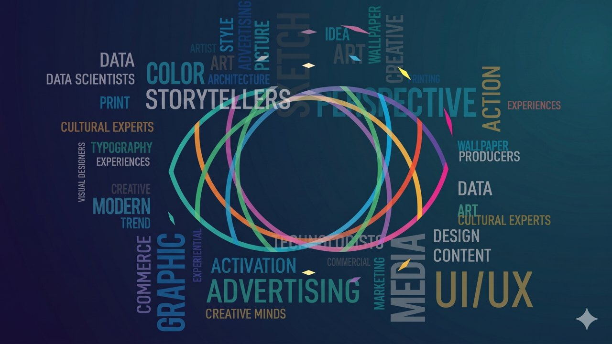
02
SECTION TWO
OUR WORK IN MOTION
Proof in practice
A look at the work we have created, the partnerships we have built and the recognition our ideas have earned.
▶

Slide 4




























































PARTNERSHIPS
Experience across categories
YOUR BRAND
HERE

Slide 5






AWARDS
Recognition for work that works
Ideas awarded for creativity, effectiveness and impact across categories.
1
3
26
14
6
Agency of the Year
Grand Prix
Gold
Silver
Bronze
RECOGNISED AT

Slide 6
03
SECTION THREE
Outcomes
Inside sparkt
Where people, practice and outcomes come together around one idea.
One
Idea
People
Practice

Slide 7



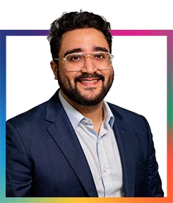
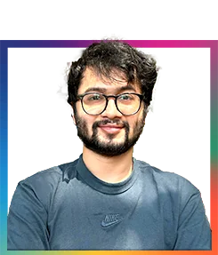

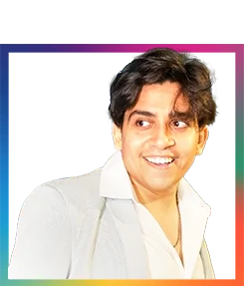
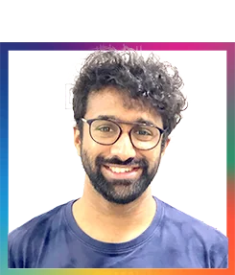

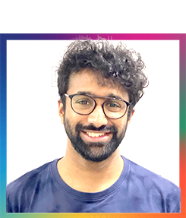
TEAM
The people behind the work
A cross-functional team across strategy, creative, technology and production.
Aditya Chandra
Pritesh Angane
Anaica Mehra
Hiren Vyas
Sarthak Gaikwad
Kanika Mathur
Managing Director & CEO
Director Planning
Brand Director
Creative Director
Director, Technology
Engineering Lead
Saurabh Pandey
Nikhil Nair
Engineering Lead
Product & UX Designer

Slide 8
OFFERING · WHAT WE DO
Consulting
Consulting
Marketing & Data Sciences
Communication
Brand & Communication Strategy
Brand Positioning
Technology
Consumer
Content
Identity & Design Systems
Integrated & Digital Marketing Strategy
Experiences
Discovery
Consumer Experience
Digital Transformation
Influence
Growth & Innovation

Slide 9
OFFERING · WHAT WE DO
Consulting
Communication
Marketing & Data Sciences
Communication
Campaigns & Creative Strategy
Social & Community Management
Technology
Consumer
Content
Corporate & Internal Communication
Marketing Collateral & Sales Assets
Experiences
Discovery
Influence

Slide 10
OFFERING · WHAT WE DO
Consulting
Content
Marketing & Data Sciences
Communication
Content Strategy
Content Development
Technology
Consumer
Content
Live Action & Production
Branded Content & IPs
Experiences
Discovery
Long-form Editorial
Motion Design
Influence

Slide 11
OFFERING · WHAT WE DO
Consulting
Discovery
Marketing & Data Sciences
Communication
Channel Planning
Search & AI
Technology
Consumer
Content
Unified Analytics
Marketing Automation
Experiences
Discovery
Customer Life Cycle
Loyalty
Influence

Slide 12
OFFERING · WHAT WE DO
Consulting
Influence
Marketing & Data Sciences
Communication
Influencer Strategy
Creator Partnerships
Technology
Consumer
Content
Influencer Campaigns
Amplification & Reporting
Experiences
Discovery
Influence

Slide 13
OFFERING · WHAT WE DO
Consulting
Experiences
Marketing & Data Sciences
Communication
Websites & Microsites
Digital Product Experiences
Technology
Consumer
Content
Interactive & Phygital Experiences
Conversational Journeys
Experiences
Discovery
Influence

Slide 14
OFFERING · WHAT WE DO
Consulting
Technology
Marketing & Data Sciences
Communication
Web & App Development
Platforms & Portals
Technology
Consumer
Content
AI Tools & Automation
MarTech & System Integrations
Experiences
Discovery
Influence

Slide 15
OFFERING · WHAT WE DO
Consulting
Marketing & Data Sciences
Marketing & Data Sciences
Communication
Measurement & Dashboards
Customer Segmentation
Technology
Consumer
Content
Personalisation & Marketing Automation
AI-led Insights
Experiences
Discovery
Influence

Slide 16
WHY SPARKT
One idea. Built across every touchpoint.
We bring together strategic thinking, creative communication, technology and production, so brands don’t just get ideas, they get ideas that are built, launched and experienced.
Consulting
Communication
Technology
Production
Brand strategy, positioning, consumer experience, integrated marketing thinking and growth roadmaps.
Campaigns, creative strategy, content, social, community and corporate communication.
Websites, platforms, digital products, marketing technology and interactive experiences.
Films, shoots, content systems, key visuals, launch assets and on-ground execution.
THE VALUE One integrated partner. Less handover. More ownership. Better thinking. Better execution.

Slide 17




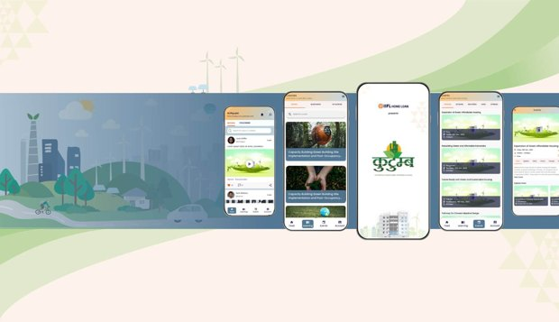
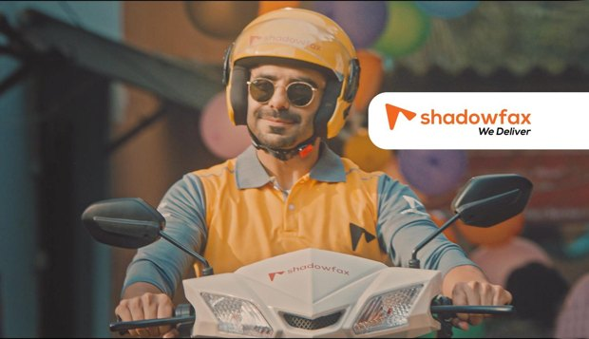
CASE STUDIES
Selected work
A snapshot of work across industries, explore the full set in the live deck.
Entertainment & Sports
View in live deck ↗
Finance
View in live deck ↗
Personal & Healthcare
View in live deck ↗
Infrastructure & Engineering
View in live deck ↗
17 cases
36 cases
31 cases
8 cases
Building Materials
View in live deck ↗
Social Impact
View in live deck ↗
Others
View in live deck ↗
2 cases
6 cases
6 cases

Slide 18
MADE BY SPARKT - PRODUCTION
Our in-house production studio
A full-service film and content team, crafting work across formats, from television to digital, music to on-ground.
TV Ads ↗
Regional Ads ↗
Stock Ads ↗
Digital Ads ↗
▶
Corporate & Product AVs ↗
Short-form Content ↗
Music Videos ↗
Podcasts & P2C ↗
On-ground Activations ↗
Made by sparkt · Showreel

Slide 19
MADE BY SPARKT - TECHNOLOGY
Our edge
How we work
Capabilities
Tech stack
Custom builds
Why clients build with us
Strategy, design and engineering together
We don’t just advise. We build.
The people who understand the problem help shape the product, architect the solution and build it right.
A hands-on engineering practice with full-stack capability across web, mobile, cloud, data and AI.
Applied AI, built in responsibly
End-to-end ownership
Retrieval, automation, agents and AI workflows designed around the right use case, data and governance.
From discovery and architecture to launch, optimisation and scale, led by senior technology teams accountable for outcomes.

Slide 20
MADE BY SPARKT - TECHNOLOGY
Our edge
How we work
Capabilities
Tech stack
Custom builds
Our engineering process
01
02
03
04
05
06
Discover
Architect
Build
Test
Launch
Evolve
Goals, requirements, constraints
System design & technical plan
Full-stack development in sprints
QA, performance & security
Deploy, harden, go live
Measure, iterate, support
ENGAGEMENT MODELS
Fixed scope
Dedicated pod
Staff augmentation
Defined deliverables & timeline
An embedded team that scales
Senior engineers in your stack

Slide 21
MADE BY SPARKT - TECHNOLOGY
Our edge
How we work
Capabilities
Tech stack
Custom builds
Our capabilities
Web Platforms
Mobile Apps
Data & Analytics
Enterprise websites & portals
Corporate / brand / product sites
Headless & traditional CMS
Web apps & dashboards
Accessibility & performance
Native, iOS & Android
Cross-platform (RN / Flutter)
App architecture & APIs
Prototype to store launch
Performance & quality
Data pipelines & ETL
Warehousing & modelling
Dashboards & reporting
Decision & ops tooling
Quality & governance
AR & Experiential
Cloud & DevOps
AI & Automation
Web AR experiences
Instagram / Facebook AR
Interactive microsites
Real-time & 3D
Event & activation tech
Cloud hosting & migration
Infrastructure as code
CI/CD & release automation
Monitoring & observability
Reliability & cost control
LLM & RAG systems
Agents & assistants
Intelligent process automation
Connectors & integrations (MCP)
Governed, source-cited AI

Slide 22
MADE BY SPARKT - TECHNOLOGY
Our edge
How we work
Capabilities
Tech stack
Custom builds
The tools we build with
Frontend & Web
Backend & APIs
Mobile
React Next.js TypeScript Tailwind Vite HTML / CSS
Node.js Python .NET C# REST / GraphQL PostgreSQL Redis Microservices
Swift (iOS) Kotlin (Android) React Native Flutter
Cloud & DevOps
Data & AI
AWS Azure Docker CI / CD Serverless Observability
LLM / RAG Vector DB MCP ETL pipelines Dashboards

Slide 23
MADE BY SPARKT - TECHNOLOGY
Our edge
How we work
Capabilities
Tech stack
Custom builds
Bespoke, not off-the-shelf
Most of what we ship is custom-built, architected from the ground up around your users, data and business.
Custom platforms
Custom integrations
Bespoke UX / UI
Built around your workflow, not forced into a template.
Connect anything: ERPs, CRMs, payments and legacy systems.
Interfaces designed for your users and engineered pixel-for-pixel.
Custom AI & automation
Internal tools & dashboards
Migration & re-platforming
Models, agents and workflows shaped to your data and operations.
Operational software tailored to how your teams run.
Move legacy systems onto modern, scalable foundations.

Slide 24
धन्यवाद
Let’s build something worth talking about.
hello@sparkt.in · sparkt.in · Mumbai, India · Dubai, UAE

